Slide 1

Elder Abuse and SMHBSS:
Implementation of Best Practices
SMHBSS Elder Abuse Working Group: Jeremy Butler, Kali Greene, Neil Elford, Pat Crawford, Roxanne Lamothe, Sheri Williams-Miller, Tricia Dominik, Vicky Willis and Kim Schryburt-Brown
January 31, 2023

Slide 2


Land Acknowledgement

Slide 3

Objectives
By the end of this session, participants will be able to:
Identify why a formal process for how a seniors mental health program addresses elder abuse was created
Identify a wide range of tools which can help identify elder abuse
Identify how inter-professional team members can work together to support a client at risk of or experiencing elder abuse
Reflect that there are no easy answers to situations involving abuse

Slide 4




Behavioural Supports Ontario
Soutien en cas de troubles du comportement en Ontario
East Region I Region de l'Est
Pr(JVidence Care
more than healthcare.

Slide 5





-
·act
cognize and port
act on
and
abuse neglect
·re:
*I Elder Abuse
Preve!' tion
On t ario
a guide to p
vent &
spond
v,nc outt r ----.
He alth
Elder Abuse Response Guide
HNlth c,,e p,Olfld«s ;an BYntal l'CN to play 1nxldrfl&lng aid« ;abuse_ Pr tor.cognize wh«Icr,t,cal lnterw.nt.ons ;are neediKI ;and k..-v howo to KCMS -IK
.tt.ctrwly. PrO\llden; c,n u• thl!li sc:r.erung tod to ;a;d UW. ra,sponsas.
must t..abi.
quoddy and
AS.Snlithot-Jtyofthl>ljl l.lOI\.
IS the older alult Silla In thn'
IS toryrfabu•hMoccun«lin;auing.Totnn
Ca,wfaobtyor RRt.ranwnt home
Long•T.rm C... ACTlON I.in.
1-866-434-0144 I www.,._lth.goY.on.a
AKhment HDmft Re9Jliltory Authority
151"1Wdw:.altr t•«IUl•..:f?
H.asacrorninalofhtnceOttUrTl'IP
- Antlwreindicaon.tt.careg....,
needssupporr>
Does h alt N111tc,omp,ft...c=yto,,. ......,...td ir,thetitwotion?
5
, ,,1,M
.,.
Who ,;.at, ASMSS Cap,Kily? Home Commun«y C.e Su t s.r....c.s
IJ)tac t dee .C;apaotyAsMa,ors. ums.Phyuoans.Ga>auo.,
M·i lfh ,M
.,.
M <u;...
-
IS the IWfMOI' 0# "-°'Attorney
wlling,lcom.ntlng tor-.fw auisunce7
-­fvocatedMna M
0SCuss c,pt,0nS. OSNSS rlSks, ond a:nsder
pn,,oey mun ard tlO"l,ra,p,e!*".is
Olsc\.ll$o:inotrnsaboutUW
wruors'wt.tyand nsbw,th;
Offial'olthePublk CworduonandTrus­
>-800-'66--0nS
.
M,ke rflWfnolS to
IfPOA teflJSHMfYICK and the
oldaradul!.is,ts.lOU!linskof
hatm.atl orofficaoltM
Public Guard.an and TruR1!41.
olo9t" adult to luppo,1
b"-'rthet",Mist:ano;e.
,,
a, nsisu,nce
L.on-gT Une
Aethm.-,tHoma Autt..ity l-8:SS-2'1S-7472
raqulred . (SN list.mg
onnext I
(SN List on NXt pa,o,tl
Pr(JVidence Care
more than healthcare.

Slide 6
Elder Abuse in Canada
Risk factors for abuse are: depression, past abuse, unmet ADL/IADL needs, not feeling safe with those closest to you, being single, living outside of Quebec and being female.
7.5% of Canadian older adults have experienced elder abuse in the past 12 months:
  2.7% Psychological Abuse
  1.6% Sexual Abuse
  2.6% Financial Abuse
  2.2% Physical Abuse
  1.2% Neglect
(Into the Light: National Survey on the Mistreatment of Older Canadians (2015))

Slide 7

Elder Abuse Ax Tools not Available
Avoiding the Issue
Don't ask quest ions related to abus -------..
No tools in EM l1Ware
Perception that nothing can be done, ...._
No prompt in init ial assessment temp late - - - - - -
- - - 1)-.
so don't bring it up
Rely on Social Worker to --------J)-.
addressissues of abuse
Mu ltip le assess ment too ls available, not all are suit able for our client populati on
-----
,_.. _ _ No mandatory elder abuse report ing
,_.. _ _ Risk/ benefit of inte rventions
Need to build trust with client before they will disclose abuse
M- - - - - - Person may not remember
or be aware of the risks
._
Balancing person' s privacy versus need for in-depth / invasive assessment
A- - - - - - -
Staff need to be constantly aware of and monitoring for red flags of abuse
Ethical/Legal Issues
Assessment Chal lenges
Pr( JVidence Care
more than healthcare.

Slide 8

What can SMHBSS do to support clients and residents who experience Elder Abuse?

Slide 9

Where We Are Now
Education blitz for staff
Yearly mandatory education for staff
Specific tools for Triage and Case Manager Initial
Assessments
Elder Abuse Tools in our Electronic Medical Record
Risk flags in EMR
Process Map and Resources (binder/folder)
Ongoing Opportunities for Elder Abuse Dialogue

Slide 10
Elder Abuse - Clinical Tools
Central Access Clinicians use the Zarit Screener during
triage
Case Managers use the Indicators of Abuse as part of their
initial assessment
All clinicians may use any of the tools, at any time

Slide 11
The Zarit Burden Interview Screener Version
Question | Score
1. Do you feel that because of the time you spend with your relative that you don’t have enough time for yourself? | 0 1 2 3 4
2. Do you feel stressed between caring for your relative and trying to meet other responsibilities for your family or work? | 0 1 2 3 4
3. Do you feel strained when you are around your relative? | 0 1 2 3 4
4. Do you feel uncertain about what to do about your relative? | 0 1 2 3 4
(Bedard et al, 2001)
Scores of 8 or higher indicate severe/high burden (Stagg & Larner, 2015)

Slide 12
Indicators of Abuse
Caregiver
Has behaviour problems
Is financially dependent
Has mental/emotional difficulties
Has alcohol/substance abuse problem
Has unrealistic expectations
Lacks understanding of medical condition
Caregiving reluctance
Has marital/family conflict
Has poor current relationship
Caregiving inexperience
Is a blamer
Had poor past relationship
(NICE, 2010)
Care-Receiver
Has been abused in the past
Has marital/family conflict
Lacks understanding of medical condition
Is socially isolated
Lacks social support
Has behaviour problems
Is financially dependent
Has unrealistic expectations
Has alcohol/medication problems
Has poor current relationship
Has suspicious falls/injuries
Has mental/emotional difficulties
Is a blamer
Is emotionally dependent
No regular doctor

Slide 13
Other Clinical Tools Available
Electronically:
BASE – Brief Abuse Screen for the Elderly
CASE – Caregiver Abuse Screen
EASI – Elder Abuse Suspicion Index
Zarit Burden Interview
Elder Abuse Charting Tool

Slide 14
A Caution…
We must understand the older adult’s culture and values
before we intervene, while acknowledging:
Our inherent privilege
Influence we have in making recommendations
for/against ideas
Respect for cultural integrity
Allow people to tell their story
Seek guidance from respected Elders in the person’s community

Slide 15





Elder Abuse ,sev,dent, suspected or d,sdosed
l
ls there imminent nskofharm"
l
Engage lnter-Profess,onal T ]
H cli•nt Ii nc:apabl• or you ar• quu t ion ln1 their c pacity, th• response depends on the type of Issue.
-Explcwe tllelr litwtlcrl andopcions
Prope,1y
.,..._,c..-
Treatmentor Admiuion to lTC
........c:..-
Olli.......
c:..
•tller9•,_.d
Aaamayln,-.?
.Provide--·If
-lsther•aPOA (Property)?
-Th• Health Cwe Consent Act
eovemsth•• decisions
c-
cllentconatts
-Ar• there inform•
wranpmef!Ufor
,p_ro_{s}pe?rty r•l•ed
lsthePOA eflactecP
.c.n""'Nlpdle
.continue SMHBSS
·---1
NtYicuwith cliant
-lsthereaPOA (personal car,e )
dlancobralla
'°"1
·- -
-Consult the
Substitute OKI-. Maker Hierwchy for decisions
-lsthe POAthe
IUJl)ected abusar?
-,.aad*-1
CllnutdleOntalD
Oisculllion with lflter1)t0felllional
te wn, revi-nm
and consider
pttvaey imiu
-Treatment
Dec isions Unit• Olltwio Public Guwdi.,.,d
Trust•• offic• •• resource .,d support
Public Guadlall
andT,-. pollca
Slld/w-....
-Is ti,ere con•nt forSMHBSS
•rvlce,
Pr(JVidence Care
more than healthcare.

Slide 16
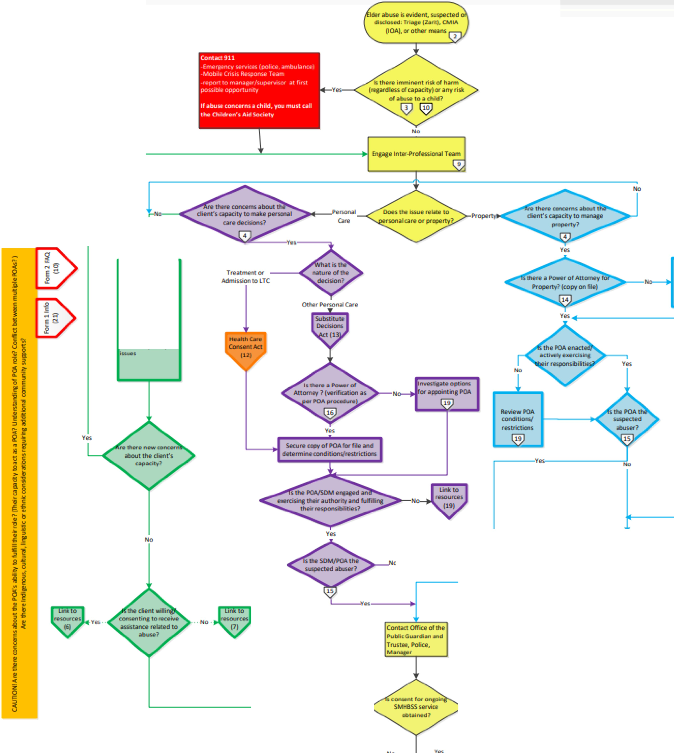
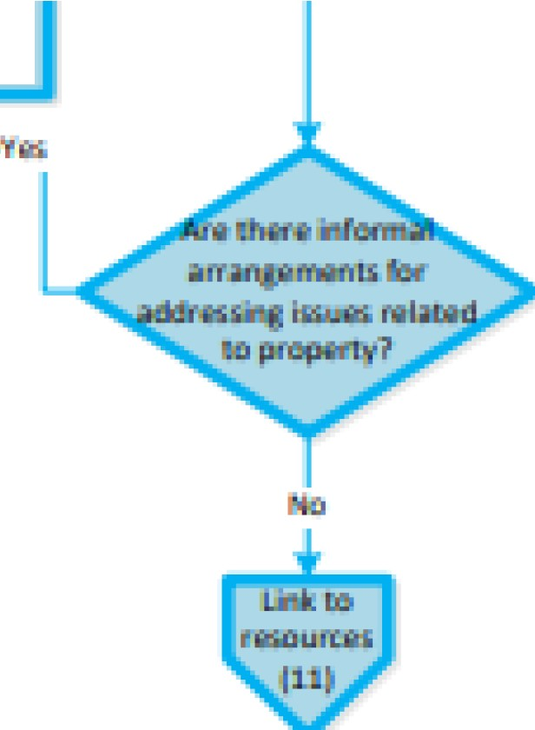

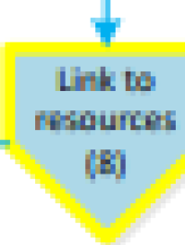
-·­
EaiiON wMIMII Iha
.........
dllfil l'...OMMM
lfwtilifilllolCllltflM t- - - - -, ro, n,...., P<»-
-
,..
UU:LllliOOft
Wllh dildt a.Id
01)00M (d "'1Ch
,U,oa ct ti1U"9
;.abaou1acJ
....."'Id;
.(.oniil'la:I iSrodlJl!Jt'l/llll'lqi.at'J'
,ntll u- iliOM
== \9
..,.. _ _ _ _ _ _ __^{.011:1£}i^{u}d^{U}tl^{W}lf^{l u}-p^{K}!^{ll}(⁾l^{tl}aªl.l^{l}l^{d}li^{i}la^{O}M^{l'I}.^{S}.
.(.on,dtilfl( Qleiii
.^{I}..
-
Hh-l•fl"l'..k... 1+1)Mi.Hrl!",
( £1"1lllu Q r ln 1 li 1 \J. MIWU
m, lu6.i,u l'l'lrt'..,. cwf""1t n i.- - - - -' - - - -+j .ttti:.odr 41 i:.•o .w l fll .r'.tH'l f
lischil\l" ' WT. '!lf1 Jl"f l!l rli"tl<rill
t i:tl ti'rt' .:I.

Slide 17
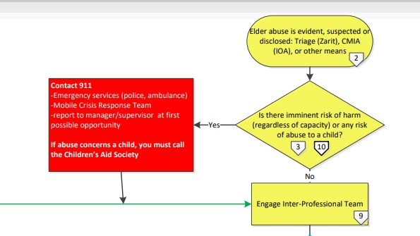


Diamonds are decision points
Key information at each step
Pentagons are clickable links to more resources

Slide 18
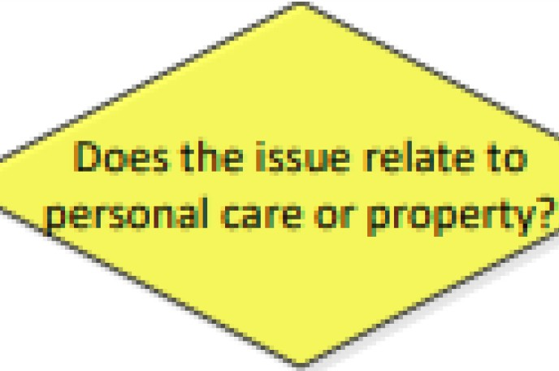
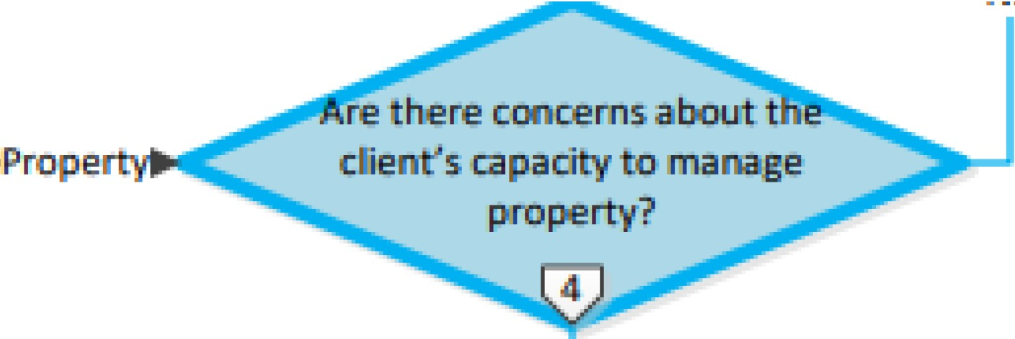
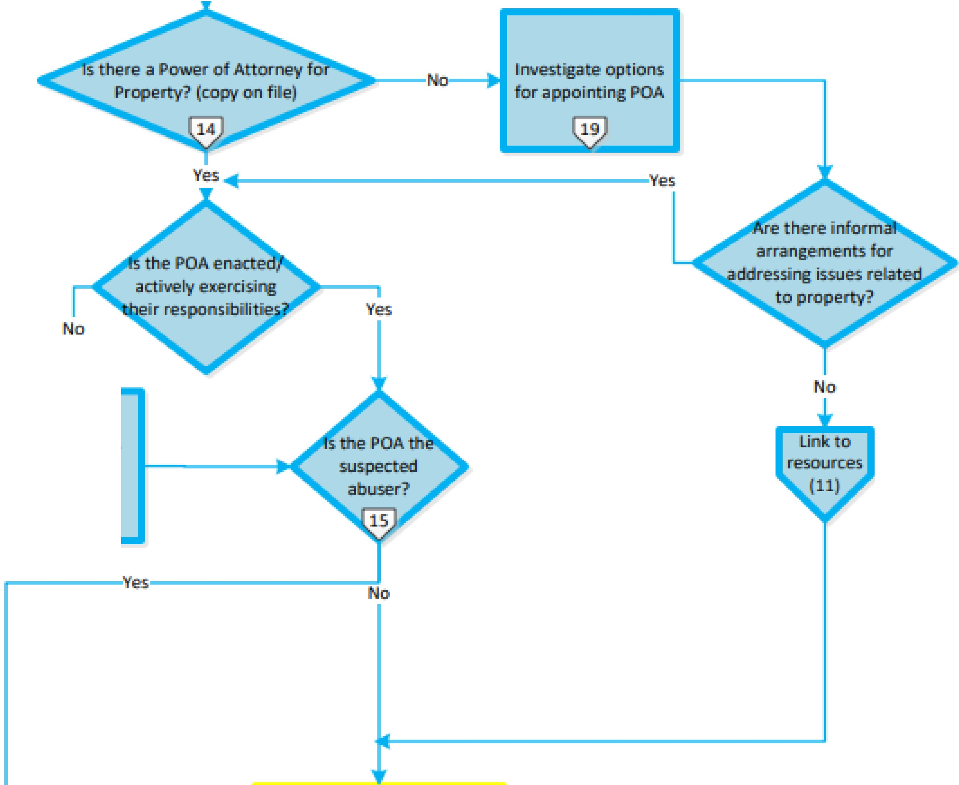


Yes
Rev iew POA condit ions/ restrictions.
1 9
N o, -'-1
Contact Offi ce ol the Public Guardi an and TrucStee, Police, Mana er
.Continue discussion / inquiry
into accusa tioos
1-'- - - -
- - - - - ,. w i t h inter-professional team,
.,_
-Discuss situation and opt ions.
circle of care
-Review risks
.Consider privacy i ssu es
Lin k to
resource s
(61
Does the POA/SDM
consent to assistance?
Yes.....-
Pr( JVidence Care
more than healthcare.

Slide 19
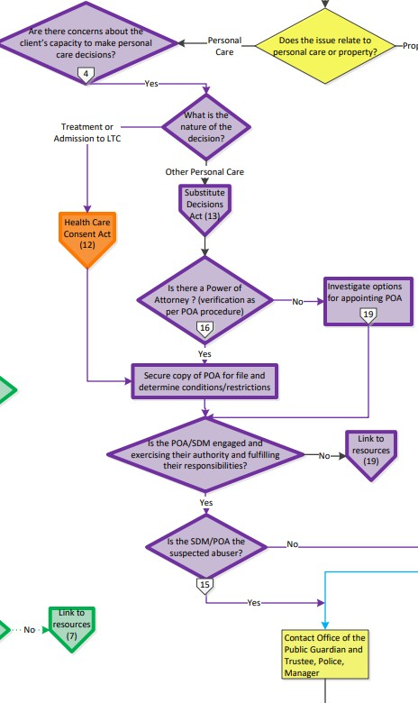
POA Personal
Care
Orange pentagon is Health Care Consent Act – treatment and admission to LTC issues
Purple is all other health care issues – Substitute Decisions Act (SDA)
Resources link back to the respective legislation, as well as ideas for interventions

Slide 20

Experiences in Our First 6 Months of Implementation

Slide 21




Education Evaluation
10
8
6
4
2
0
10
8
6
4
2
0
Pre Post
Pre Post
I know where to find tools to address abuse once it is discovered
I use elder abuse tools to screen all clients for elder
abuse
14
12
10
8
6
4
2
0
12
10
8
6
4
2
0
Pre
Post
Pre Post
I know how to objectively document my suspicions of elder abuse
I know what community resources and partner agencies are available to support a person whom I suspect is experiencing elder abuse

Slide 22
Implementation – Month 1
Triage Initial Assessment
16
35
14
30
12
25
10
20
8
# Ax
# IOA
15
# referrals
Zarit
6
10
4
5
2
0
0
SMH Kingston SMH FLA SMH HPE
Central Access Central Access Central Access
FLA HPE Kingston
Team 1 Team 2 Team 3
Team 1
Team 2
Team 3

Slide 23

Implementation – Month 6
Central Access – Team 1 Initial Assessment - Team 1
35
30
25
20
15
10
5
0
62%
14
12
10
8
6
4
2
0
175%
Jun-22
Jul-22 Aug-22 Sep-22 Oct-22 Nov-22 IOA Total IA
Dec-22
June
July
August Sept
Oct
Nov
Dec
Zarit
Referrals
 | Psychological | Financial | Physical | Sexual | Neglect
SMHBSS | 0.53% | 1.2% | 1.1% | 0 | 1.66%
Canada | 2.7% | 2.6% | 2.2% | 1.6% | 1.2%

Slide 24
Where We Hope To Be…
Maintain staff confidence in ability to address elder
abuse
Accurately capture incidence of elder abuse in SMHBSS and awareness of trends over time
Safe mitigation of risk in elder abuse cases with collaborative team approach and community partners
Organization-wide monthly drop-in for large group discussion on challenging situations with peers in a supportive and knowledgeable environment.

Slide 25

Resources Available At: Elder Abuse and Seniors Mental
Health: Implementation of Best Practices | brainXchange
Our Contact Information: Sheri Williams-Miller williams@providencecare.ca Tricia Dominik dominikt@providencecare.ca

